Slide 1
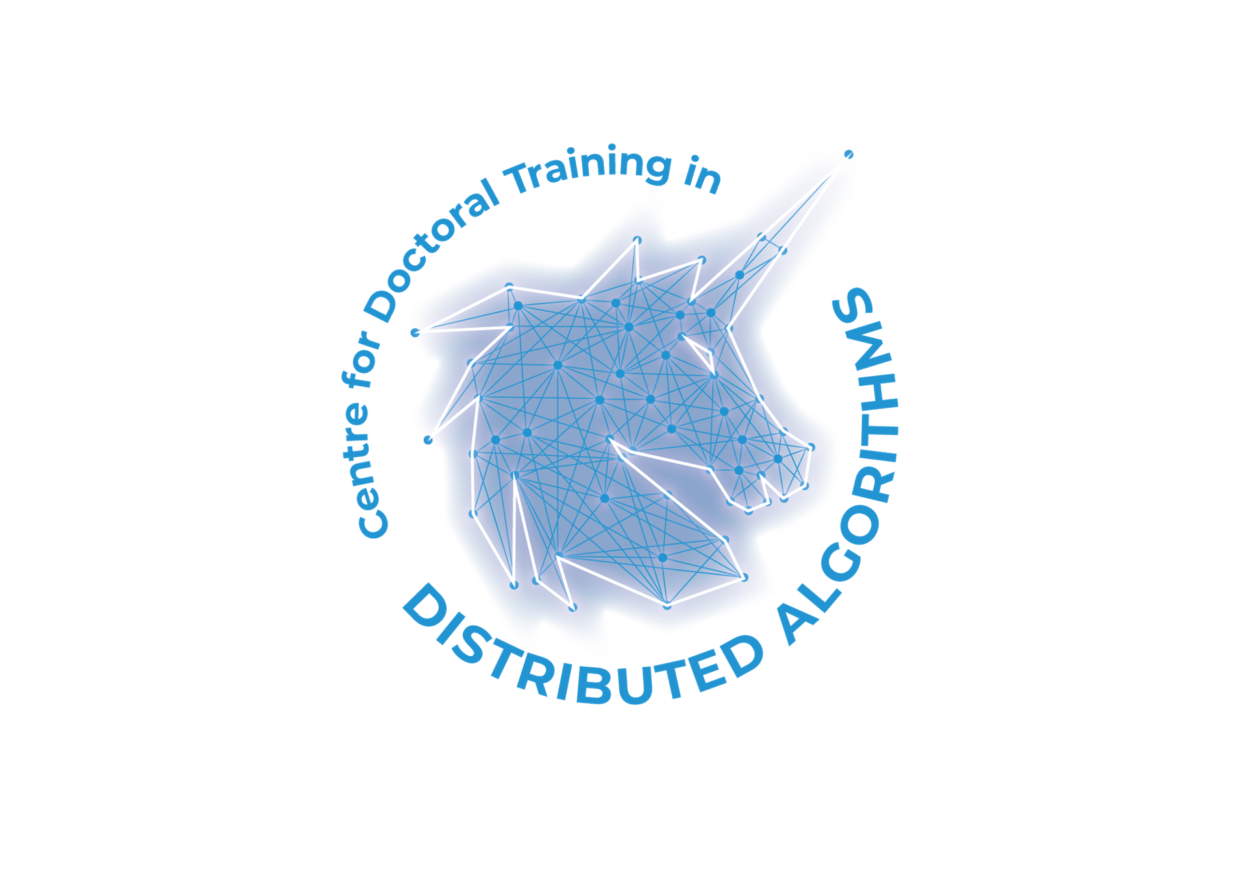
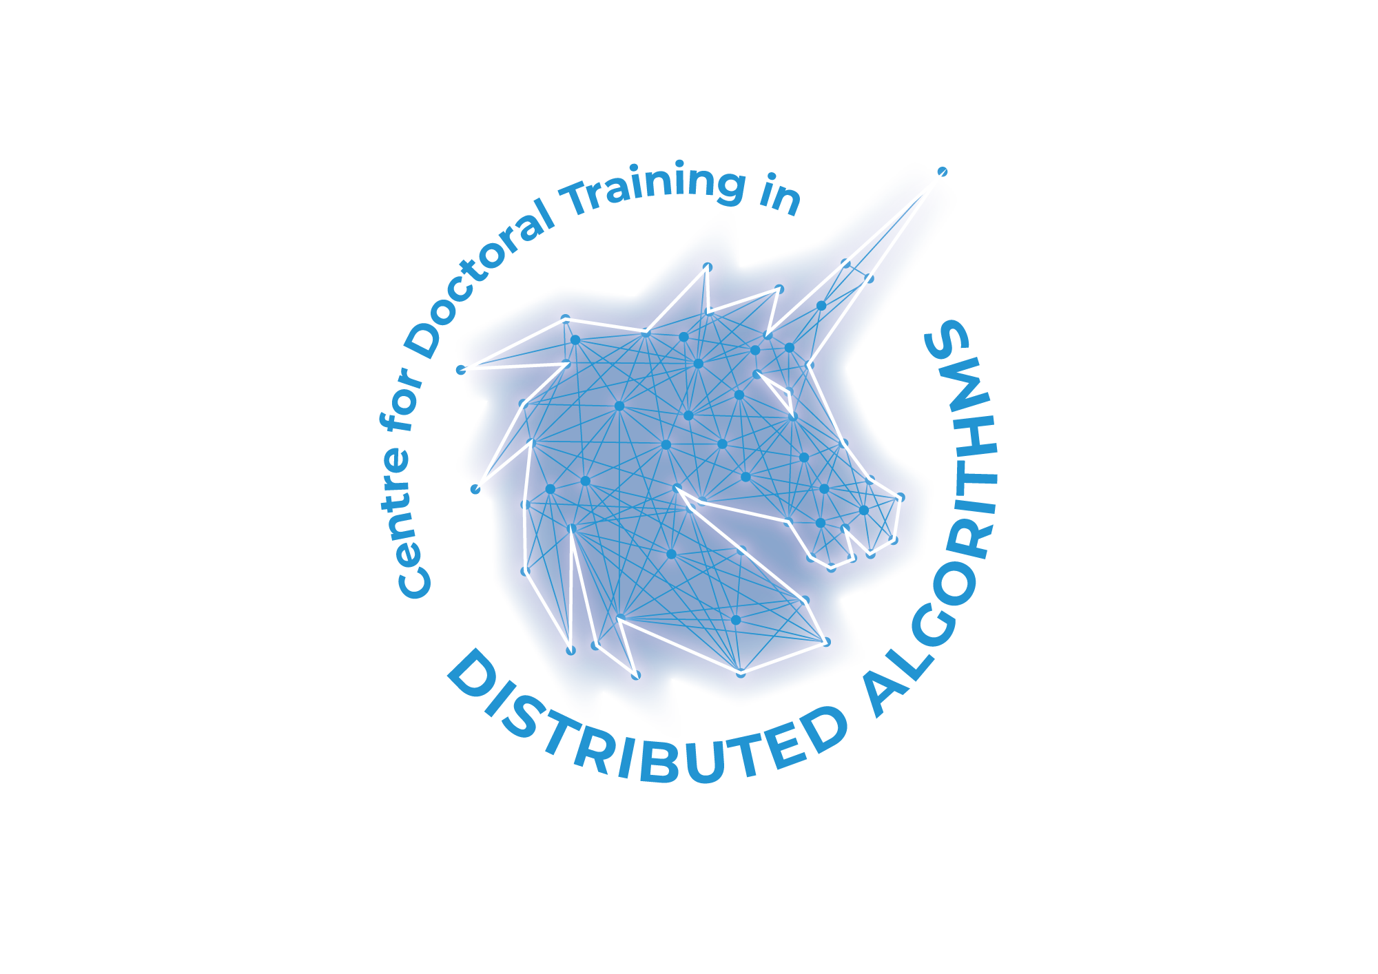


Distributed Algorithms CDT Showcase
7 December 2022, London

Slide 2
Gaussian Processes

Slide 3
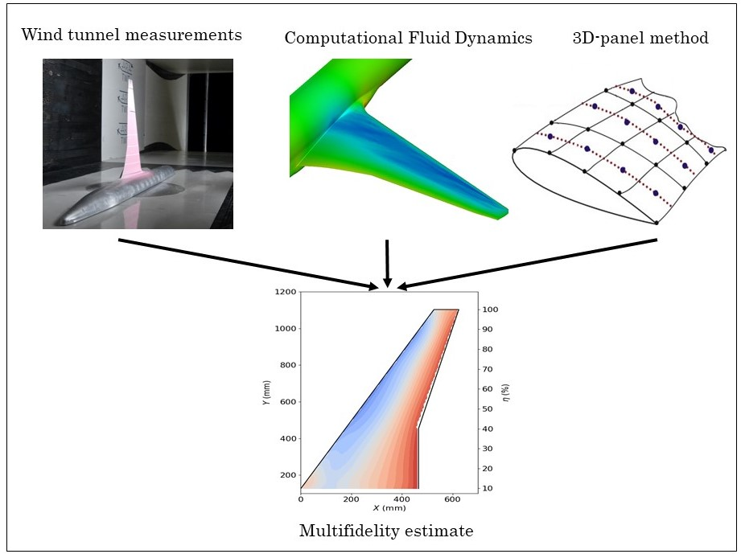
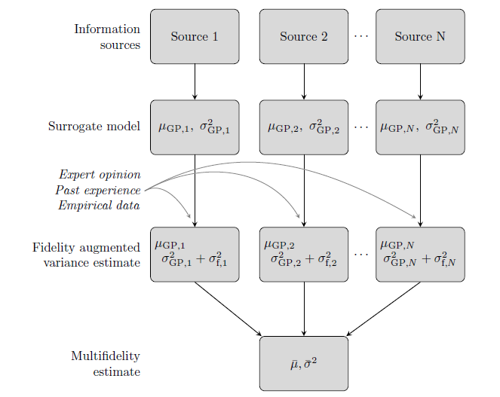


Towards Data Driven Aerodynamic Models: Data Fusion of Experiment and Simulation
Context
Multifidelity methodology
Figure 1: Schematic representation of the multifidelity data fusion.
Figure 2: Combination of Gaussian processes with augmented variance.
Feldstein et al.(2020, DOI: 10.2514/1.J058388)
Mehdi Anhichem

Slide 4
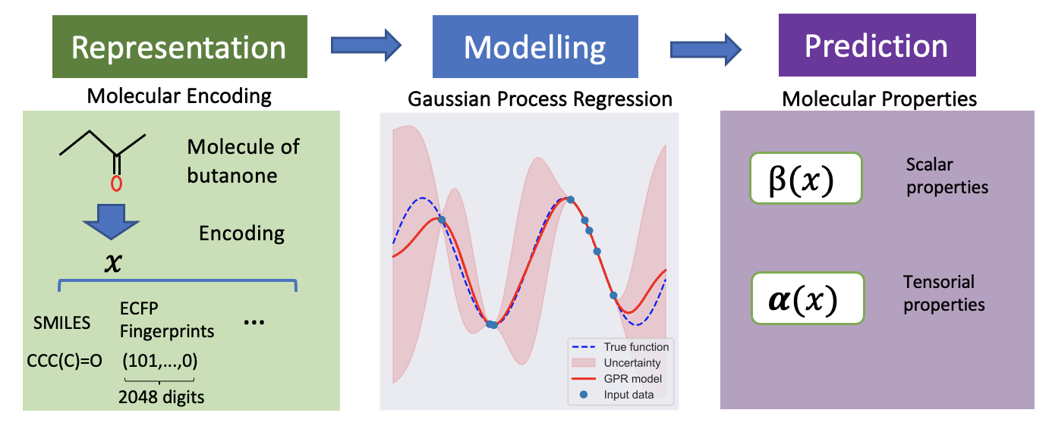


Artificial Intelligence for Fast Discovery of Novel Materials for Healthcare
Jinhao Gu, Supervised by Ángel Garcia-Fernandez, Robert Firth (STFC), Rasmita Raval, Joanne O’Keeffe (Unilever)
Creation of a new generation of materials benefits both public hygiene and infection treatment.
Challenge:
No appropriate technique can be applied and scaled to large experimental dataset.
Aims:
Bayesian Optimisation
Machine Learning
High-performance Computing
Discovery
Optimisation
Development
Advanced Materials
Accelerate
Figure: Process of Molecular property prediction
Jinhao Gu

Slide 5
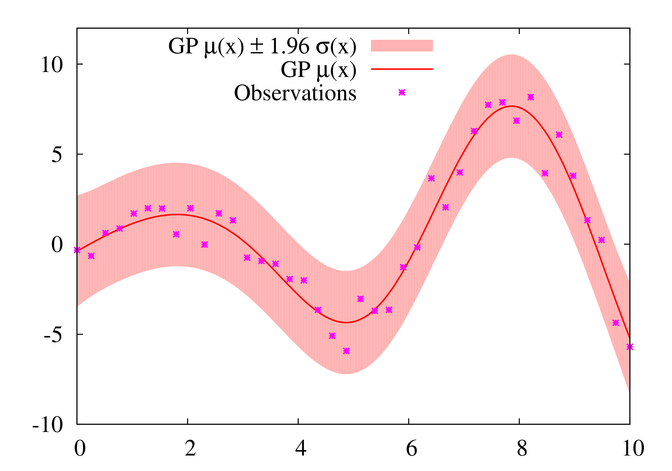
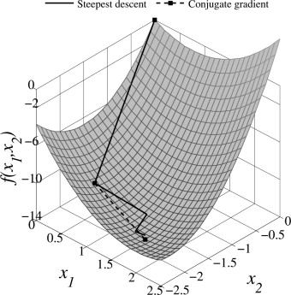
Adaptive, Iterative Gaussian Processes
Adam Lee

Slide 6
Advanced Bayesian Algorithms

Slide 7
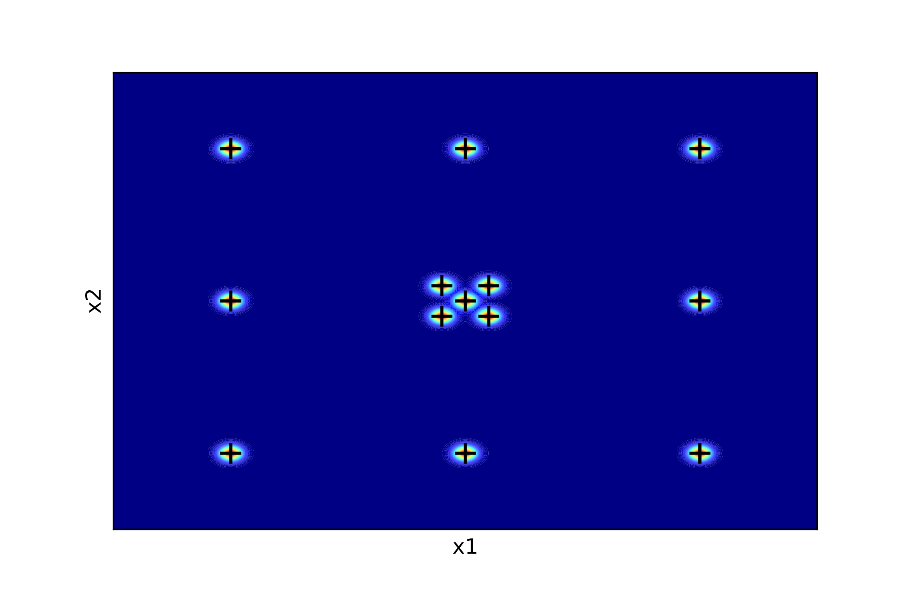
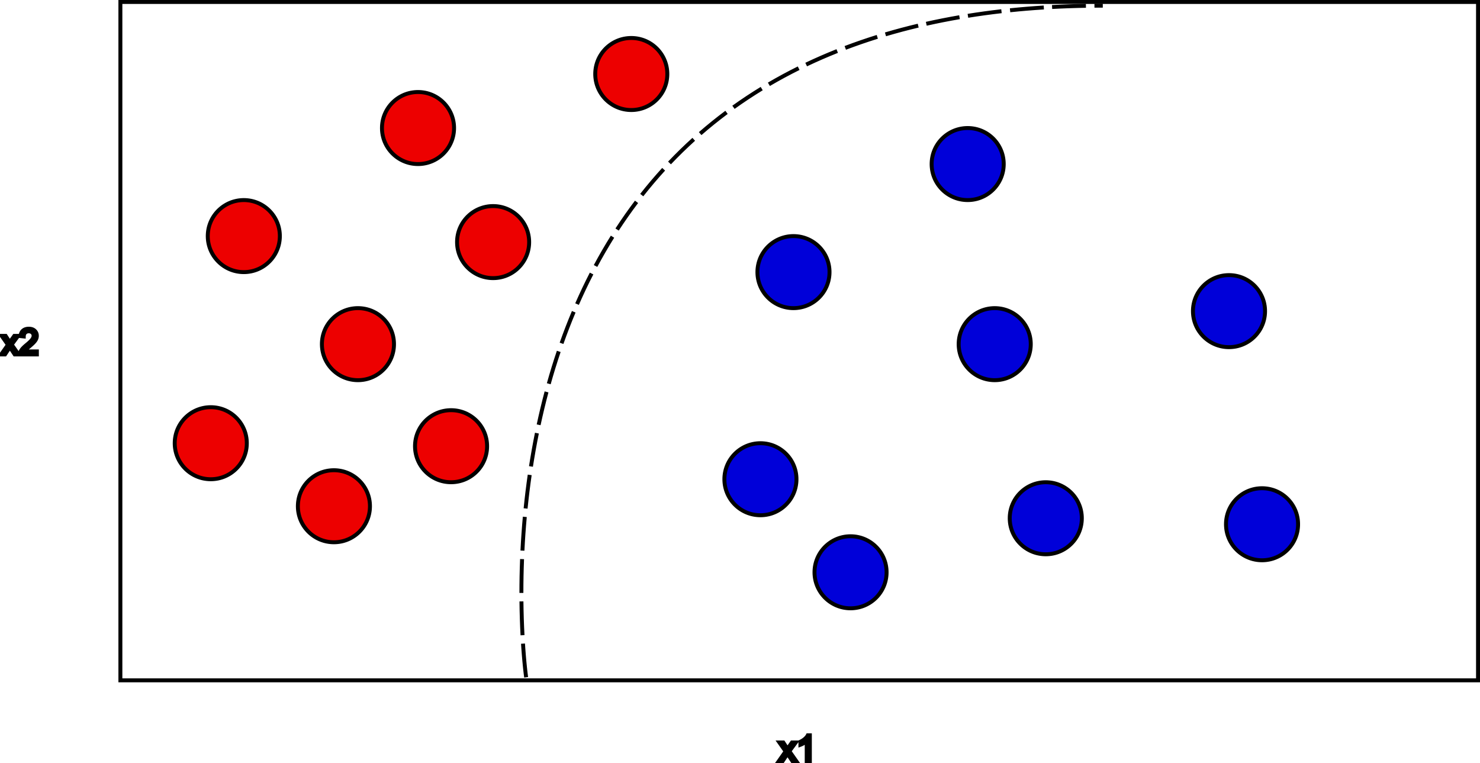
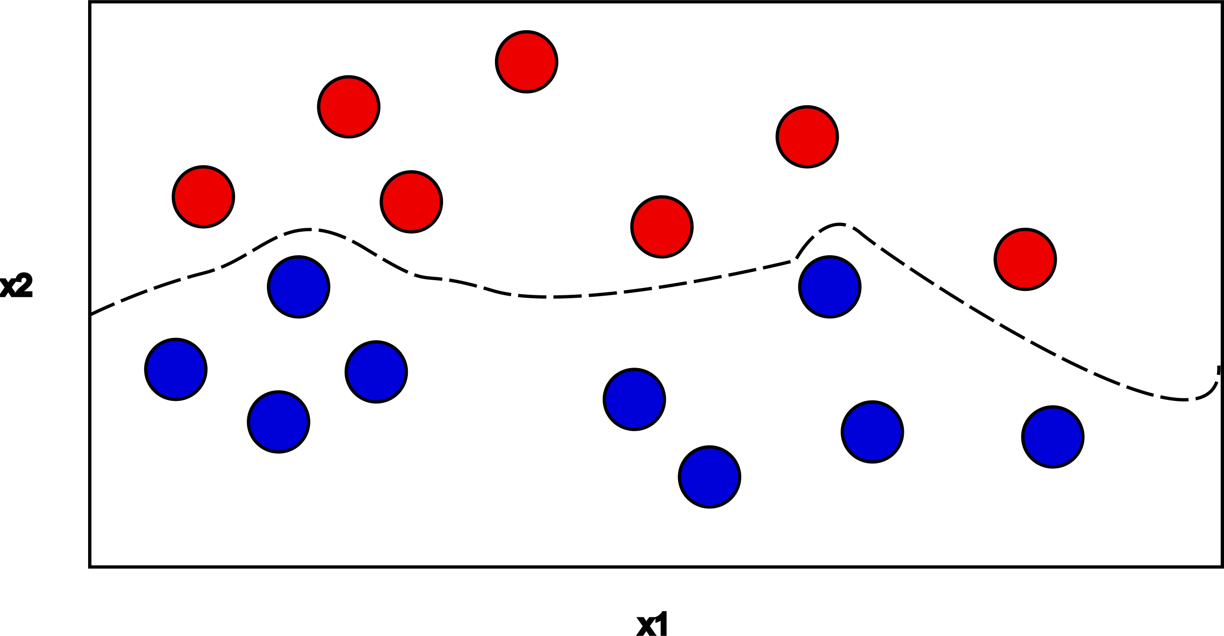

Scalable Online Machine Learning
Multiple Local Optima
Limited Memory
Concept drift
Joshua Murphy

Slide 8
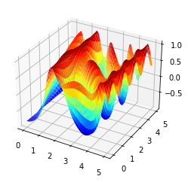
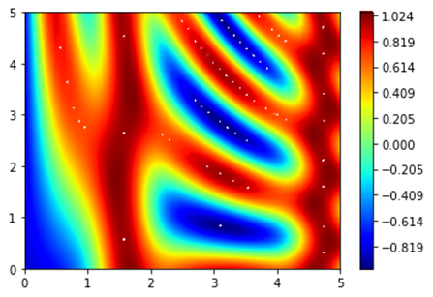
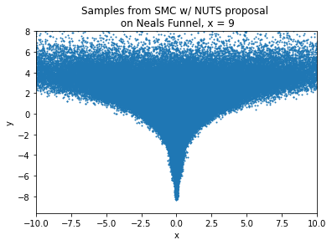
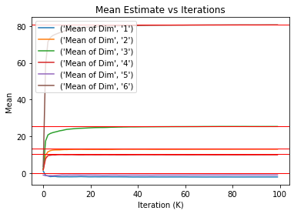

Scalable Online Machine Learning: Adaptive Mass Matrices in SMC Proposals
Andrew Millard, Supervised by Professor Simon Maskell (UoL) and Dr Simon Goodchild (STFC Hartree Centre), Sponsored by GCHQ
Project Overview:
Utilizing SMC Sampler with NUTS proposal
Improving upon the proposal with an adaptive mass matrix calculated from gradients to get better estimates of the variance
Testing with both local and global mass matrices
Using adaptive numerical integrator instead of Dual Averaging to adapt the step size
For use on high dimensional models with complex probability landscapes
Andrew Millard

Slide 9
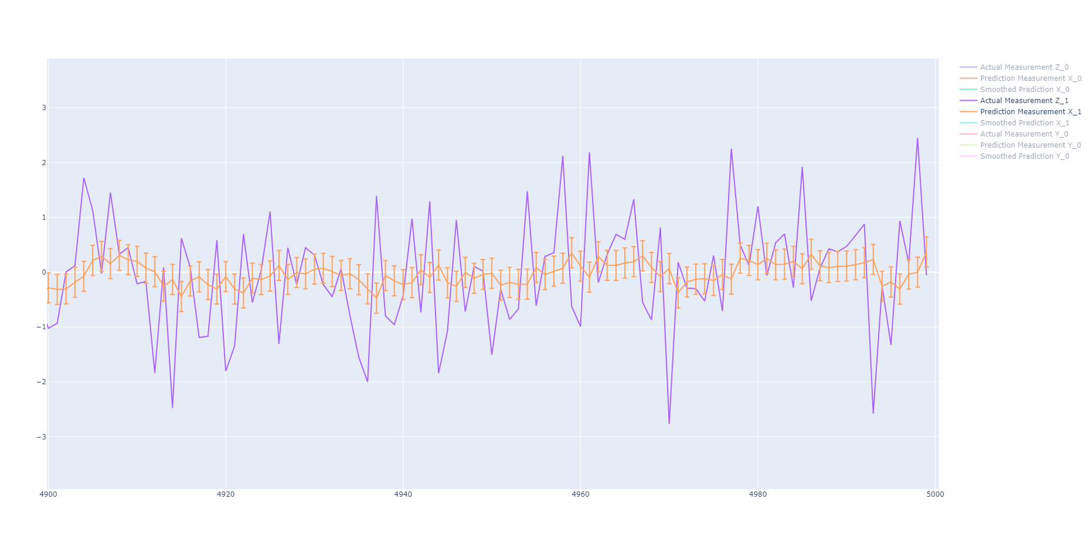
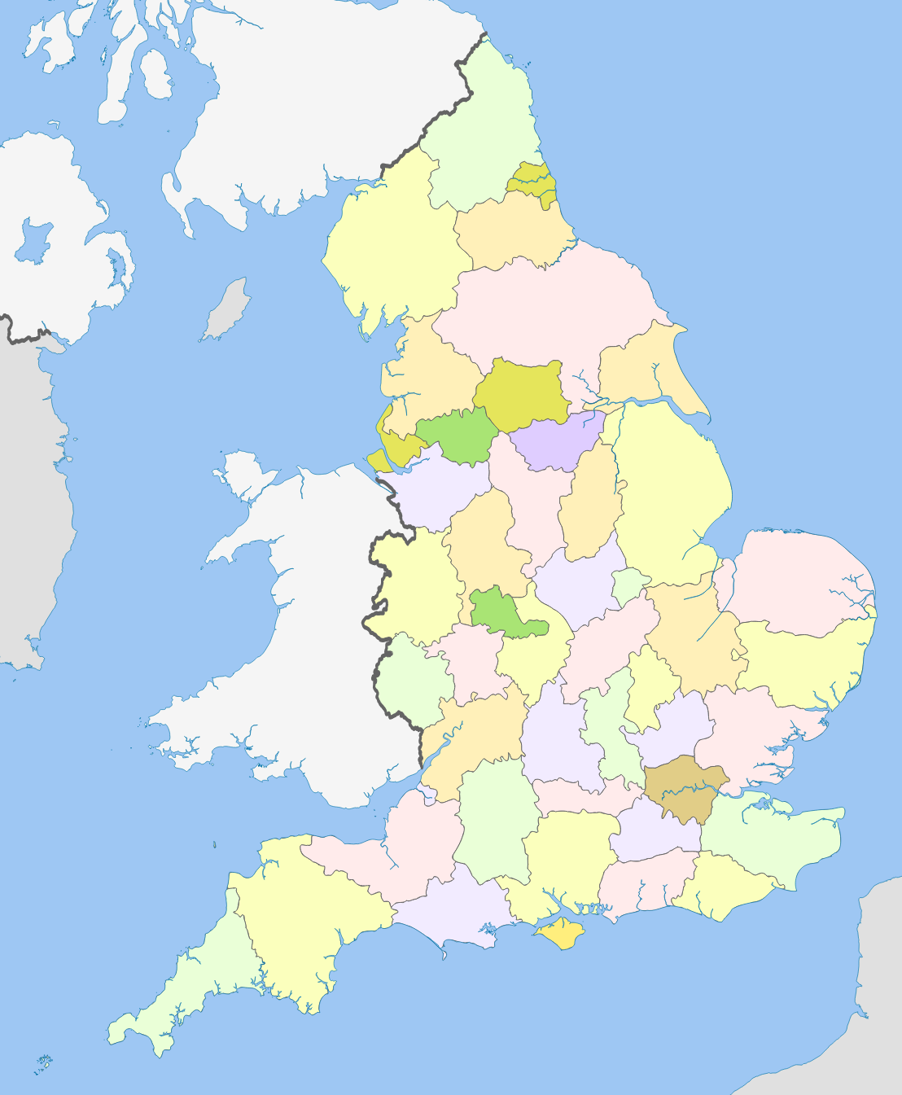

Data Driven Intelligence for Countering Crime
Kalman Filter smoother Expectation Maximisation​
Tweet Localisation​
The Kalman filter EM is a combination of three algorithms, Kalman Filter, Smoother and the EM algorithm.​
Filtering algorithm that can be adapted on other algorithms to filter measurements and improve predictions ​
The NCA is interested in finding the differences that exist in the UK between public opinion on the change in crime and the actual reported data.​
The 'worry of crime' that the public has. ​
A major influence on decisions taken by the police is to keep the public satisfied, usually expending unnecessary resources ​
Panagiotis Pentaliotis
Notes:
9

Slide 10
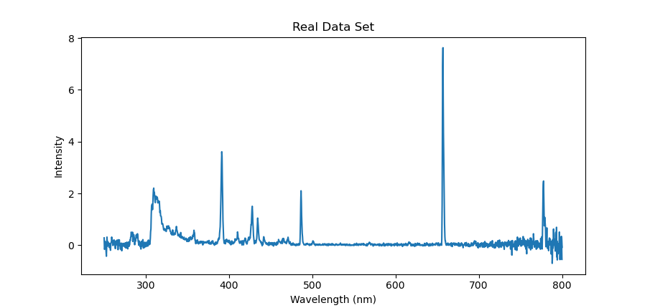
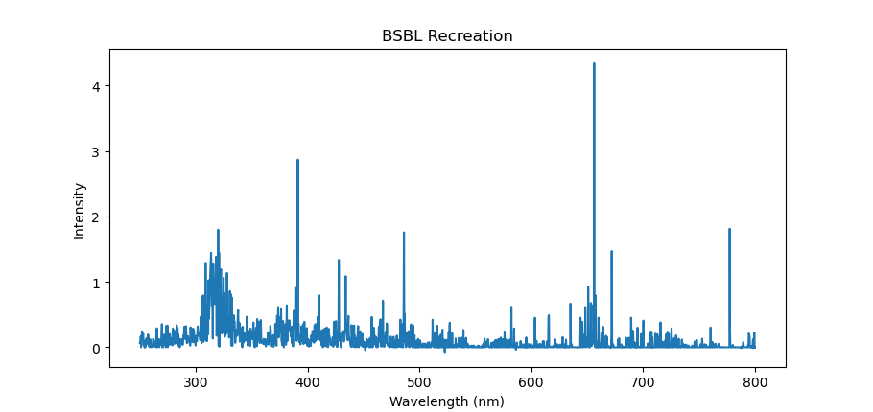

Block Sparse Bayesian Learning (BSBL) For Plasma Optical Emission Spectra (POES) Analysis
POES analysis can be represented as compressed sensing problem.
State vector is a concatenation of sub-vectors.
BSBL can be used to solve POES effectively.
Working on parallelization of BSBL algorithms to improve speed, accuracy and scalability.
Element/Molecule | Maximum Value | Values
H | 4.345 | 4.345
N2+ | 2.939 | 2.939, 0.357
O | 1.812 | 1.812, 0.392, 0.190, 0.178, 0.028
YCl | 1.129 | 1.129
Oisín Boyle

Slide 11

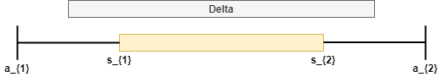
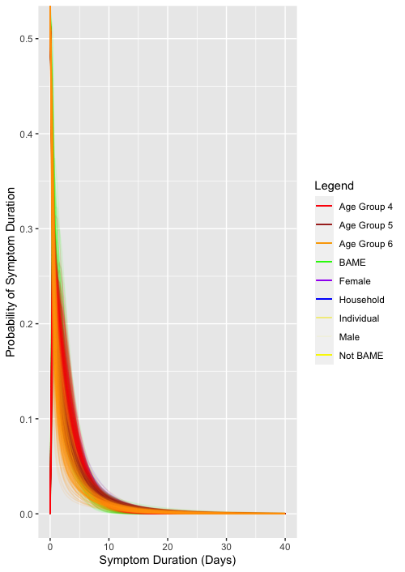
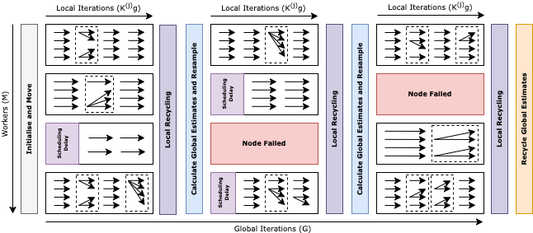



Uncertain Heterogeneous Algorithmic Teamwork (UHAT)
Matthew Carter [m.j.carter2@liverpool.ac.uk, https://mjcarter.co]
Supervised by Simon Maskell, Paul Spirakis and Edward Pyzer-Knapp
Opportunistic Sequential Monte Carlo
Natural Language Processing
COVID-19 Modelling
Sequential Monte Carlo (SMC) Samplers are population-based algorithms for numerical Bayesian inference
The University of Liverpool, IBM Research and STFC Hartree Centre previously developed a parallel SMC sampler to exploit homogeneous super-computing hardware
UHAT developed opportunistic SMC samplers which utilise a large number of distributed heterogeneous commodity-computing hardware (i.e. a mix of desktop PC’s, GPU’s and mobile phones)
Project Aim: Analyse academic publications to gain an understanding of the landscape of relevant markets and support academic and industrial ventures
Interest
Societal and Economic Benefit
Computational Expense
Prior Investment
Matthew Carter

Slide 12
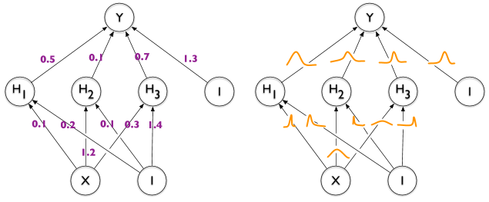





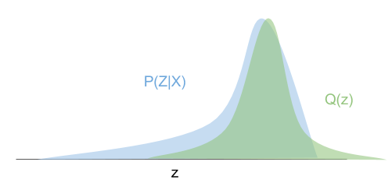
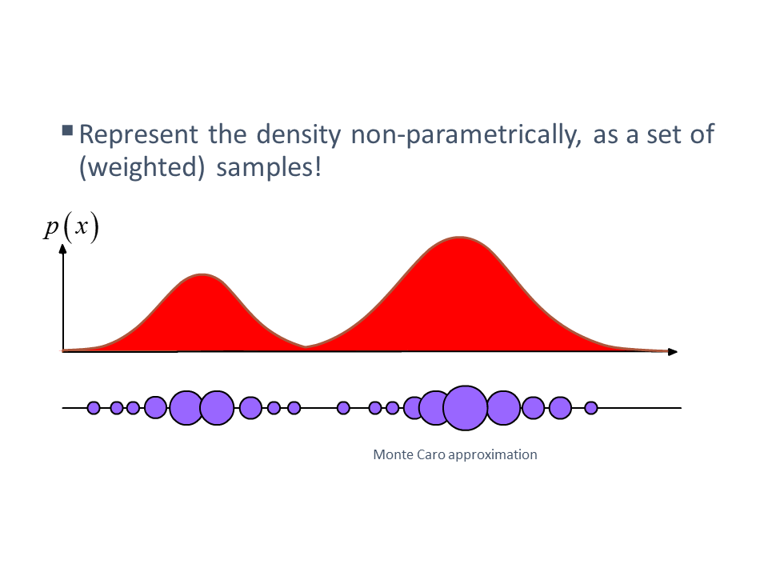
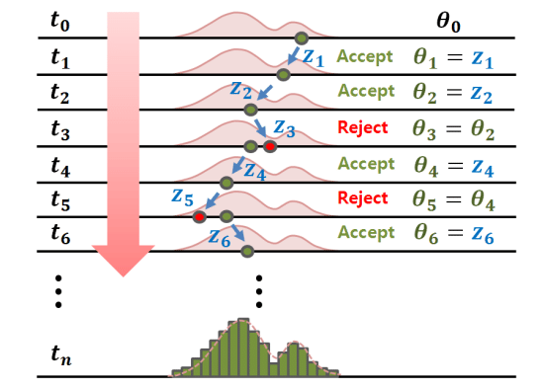
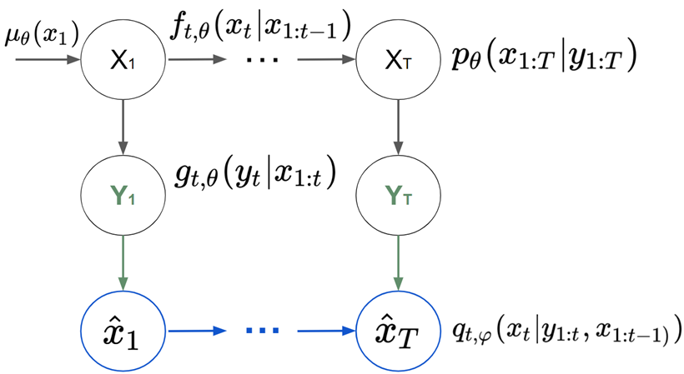
Industrial Partner (GCHQ) context:
Spot terrorist behaviours based on web traffic logs (initially), now VAE:.
→ High Dimensions.
→ Need for uncertainty estimate.
FAST BAYESIAN DEEP LEARNING
Vincent Beraud supervised by Simon Maskell and Vassil Alexandrov
Each weight is a distribution that we need to infer
SMC methods
Fusion between Bayesian statistics and Deep Learning.
Some fields require uncertainty: Health, Security, Finance, Insurance, etc.
Generally: Decision making
AI is facing uncertainty issues: Racist labelling, Autopilot, COVID forecast etc.
SMC samplers
SMC SAMPLERS
Handles multimodality
Distributed Hypotheses
Particle Filters
EnKF
Current Literature Review and the proposed architecture:
Accuracy :
Sampling of the posterior distribution
Speed:
Currently : Reduced computation time per sec.
Targeted : Reduced computational tim per flop.
MCMC Methods
Variational Inference
SMC Samplers
Markov Chain Sampling
Proposal optimisation
Particle MC
Compuationaly Slow
Accurate Uncertainty
Computationally Fast
Inaccurate Uncertainty
Computationally Fast
Accurate Uncertainty
Goal: Build a SMC sampler that can fit into a neural network to create a Bayesian neural network.
Main issues:
SMC sampler has a component (L Kernel) that does not suit high dimensions.
SMC methods are hard to differentiate because of resampling.
Vincent Beraud

Slide 13
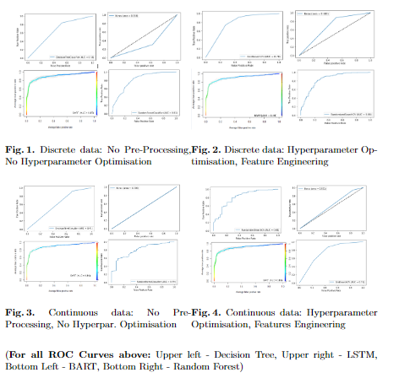
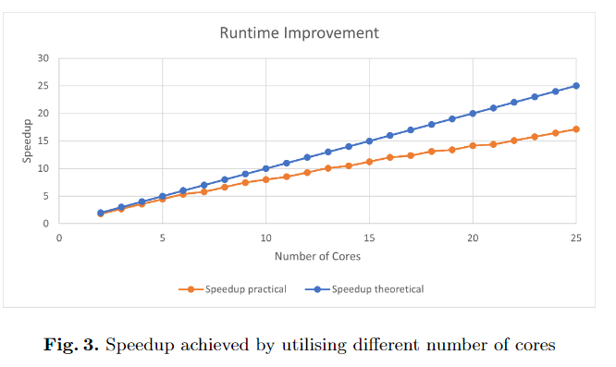
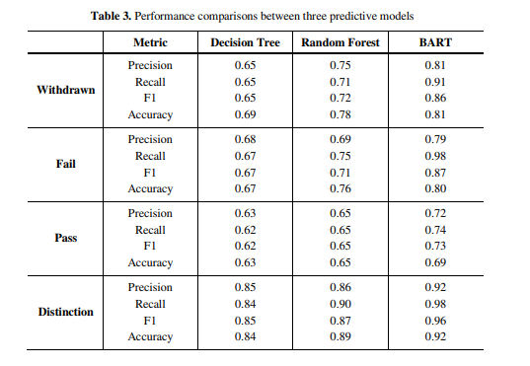


Enhancing tree-based algorithms performance
Improving Run Time
Multi core architectures to improve probabilistic trees, run time
General Aim: Take advantage of the state of the art accuracy of those slow algorithms and make them widely applicable on time crucial problems
Improving Accuracy
It is generally considered that tree based algorithms are not as accurate as other state of the art algorithms(e.i neural networks)
General Aim: Improve tree based algorithms accuracy through probabilistic and non probabilistic methods.
Solve real world problems through transparent algorithms
Use real life problems with the novel algorithms we produce, and show how they can be used in real life scenarios
Examples: Predict students dropout as early as possible
Predict crime rate
Predict student with STB
Efthyvoulos Drousiotis

Slide 14
Image Processing

Slide 15
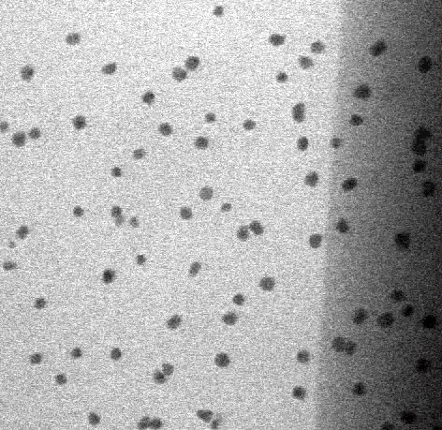
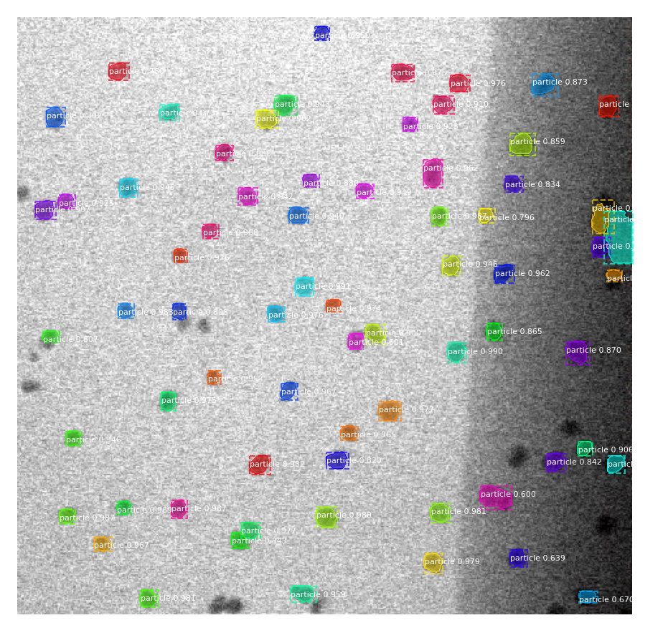
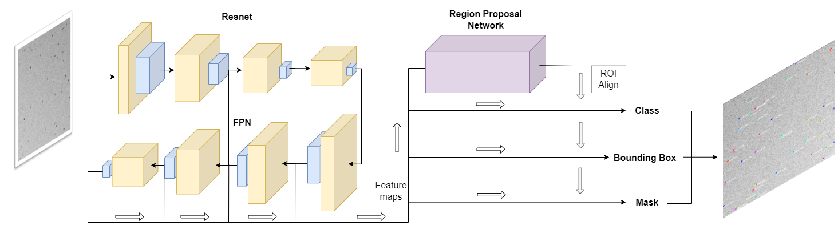
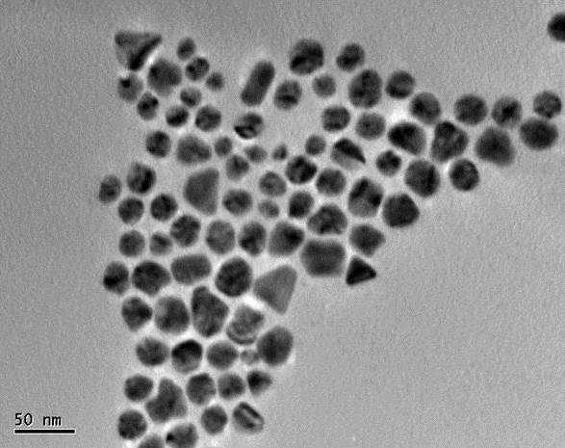
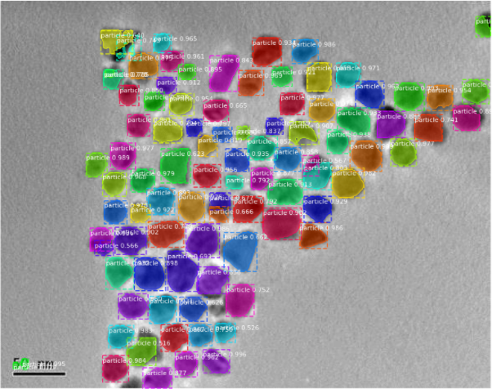
Machine Learning Tracking and Detection for Nanoparticle Feature Analysis
With this project, we are looking to:
Develop a CNN model for the tracking and analysis of Nanoparticles with high levels of noise in STEM microscopy images.
Integrate an efficient and performant CNN model for use with subsampled images.
Machine Learning Tracking and Detection Model for Nanoparticle Feature Analysis
Figure 1: Network architecture for a Deep Learning implementation of segmentation and region proposal network inspired my MASK-RCNN, FPN and Faster R-CNN.
Figure 2: Transfer Learning MASK-FPN/RPN results for particle prediction from our training and network reshaping.
William Pearson

Slide 16
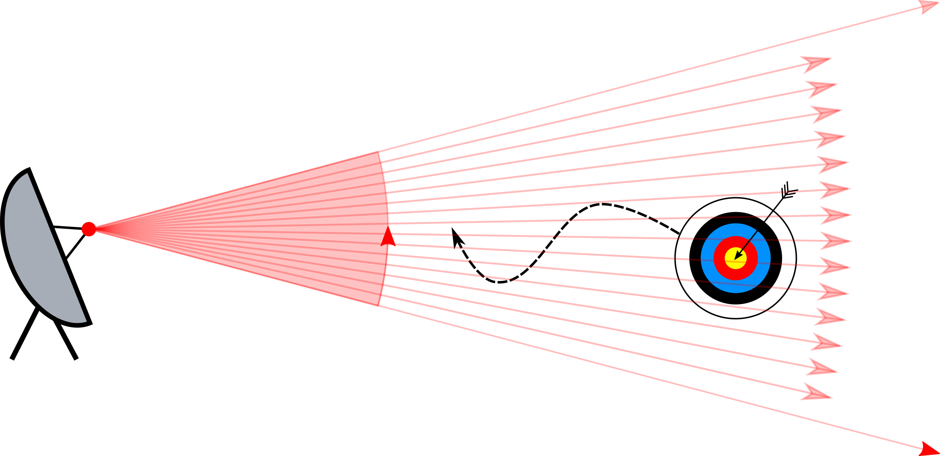
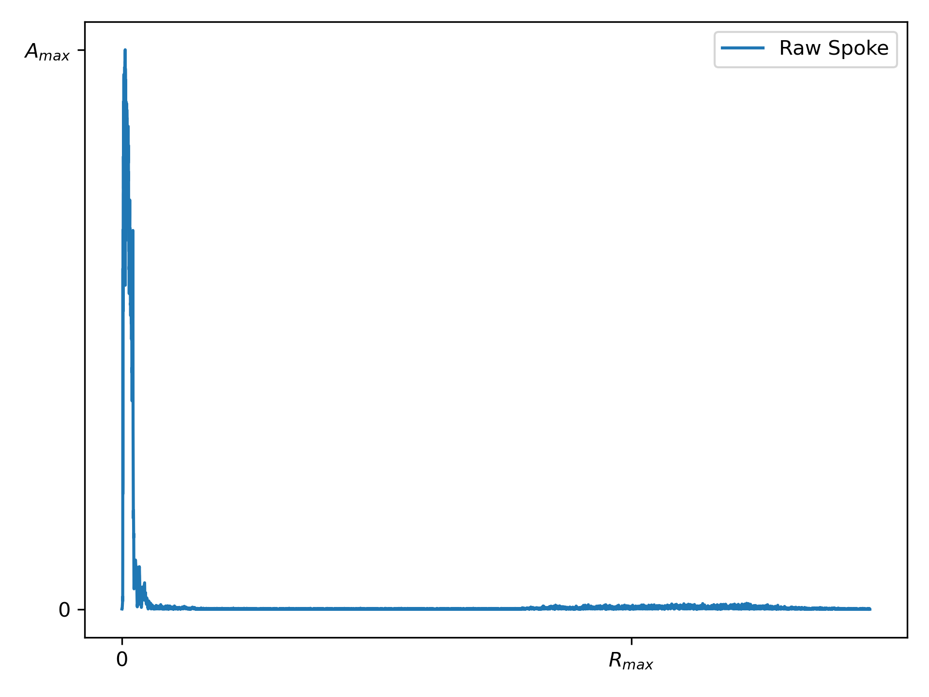
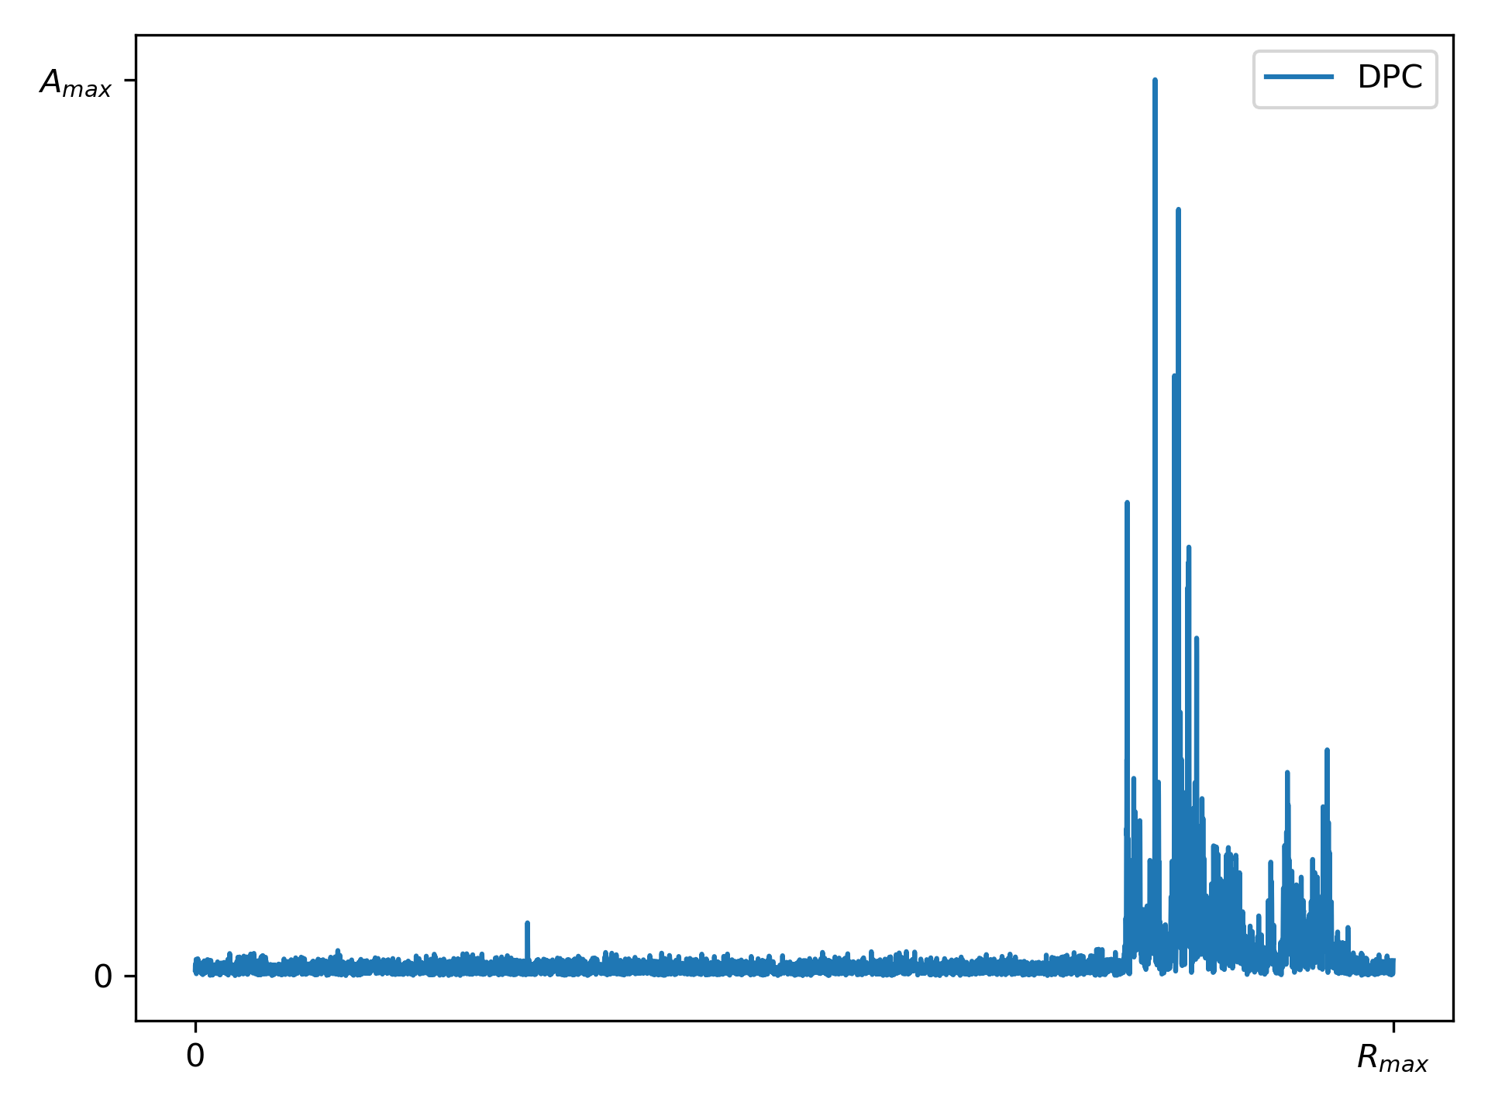
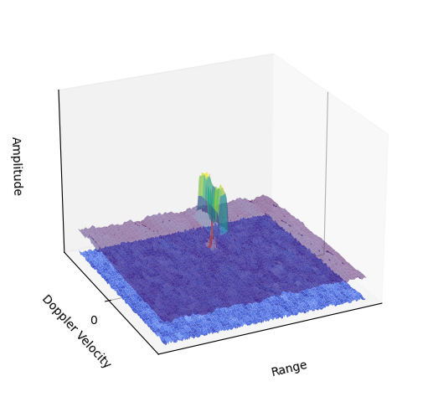

Machine Learning for Object Detection and Classification for Multimodal Airborne Sensor Data
Ocean surface surveillance uses many forms (modes) of data
Pulse-Doppler radar collected in different resolutions
Other sensors collect unique features of target
Extensive preprocessing required
ML could be used instead for fusion and detection
Chris Blackman

Slide 17
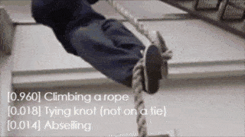

Project title: Video Based Human Action Recognition Via Deep Learning Algorithm
Jianyang Xie, Main Supervisor: Yalin Zheng, Second Supervisor: Anh Nguyen, Industry Supervisor: Xiaoyun Yang (Remark AI)
Briefly Introduction
Main Challenges
Project Plan
Accuracy: affected by the complexity of the visual data (camera viewpoints)
Accuracy: Combining body skeleton information with video appearance
Data: Heavily relying on annotated data, prone to be overfitting
Data: Developing self-supervised model to alleviate data annotation dependencies
Aim：recognize the action in a video precisely and give a label to it
Model Size: too big to be integrated into industries' application
Significance：has a wide range of applications such as video surveillance
Model Size: Neural Architecture Search method for lightweight model
Jianyang Xie

Slide 18
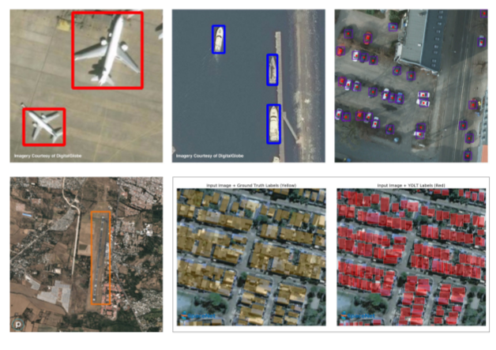
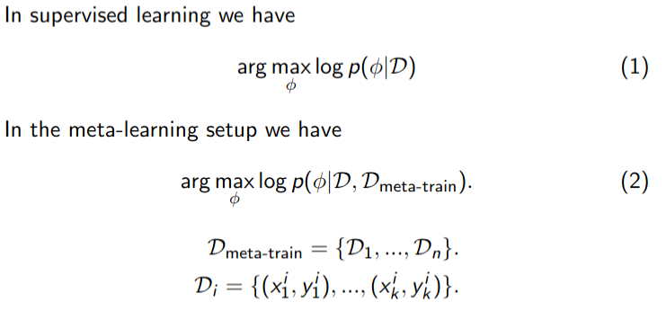

Meta-Learning for Object Detection in High Resolution Airborne Imagery
Ben Rise
Notes:
18

Slide 19
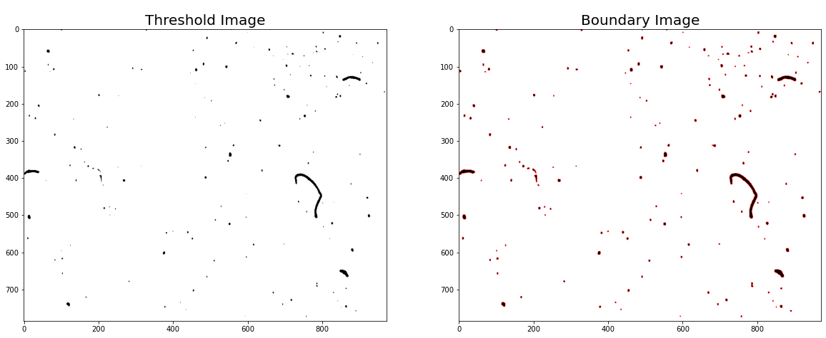

Data Science and Artificial Intelligence for smart sustainable plastic packaging
I have started by looking at polyethylene films which are used to make flexible plastic packaging.
Overarching aims of the project:
Characterise the type, size, shape and spatial distribution of gel spots for a range of different PE films with different PCR content/PCR feedstocks.
Predictively link this information about gel distributions to relevant performance properties of the films (sealability, likelihood to tear etc).
Go back to the original PCR pellets to see whether the distribution of gel spots could be predicted from indirect structural information (e.g FTIR/DSC/XRD). This would allow us to predict what will make a good pellet in advance of making large amounts of film from it.
William Jeffcott

Slide 20

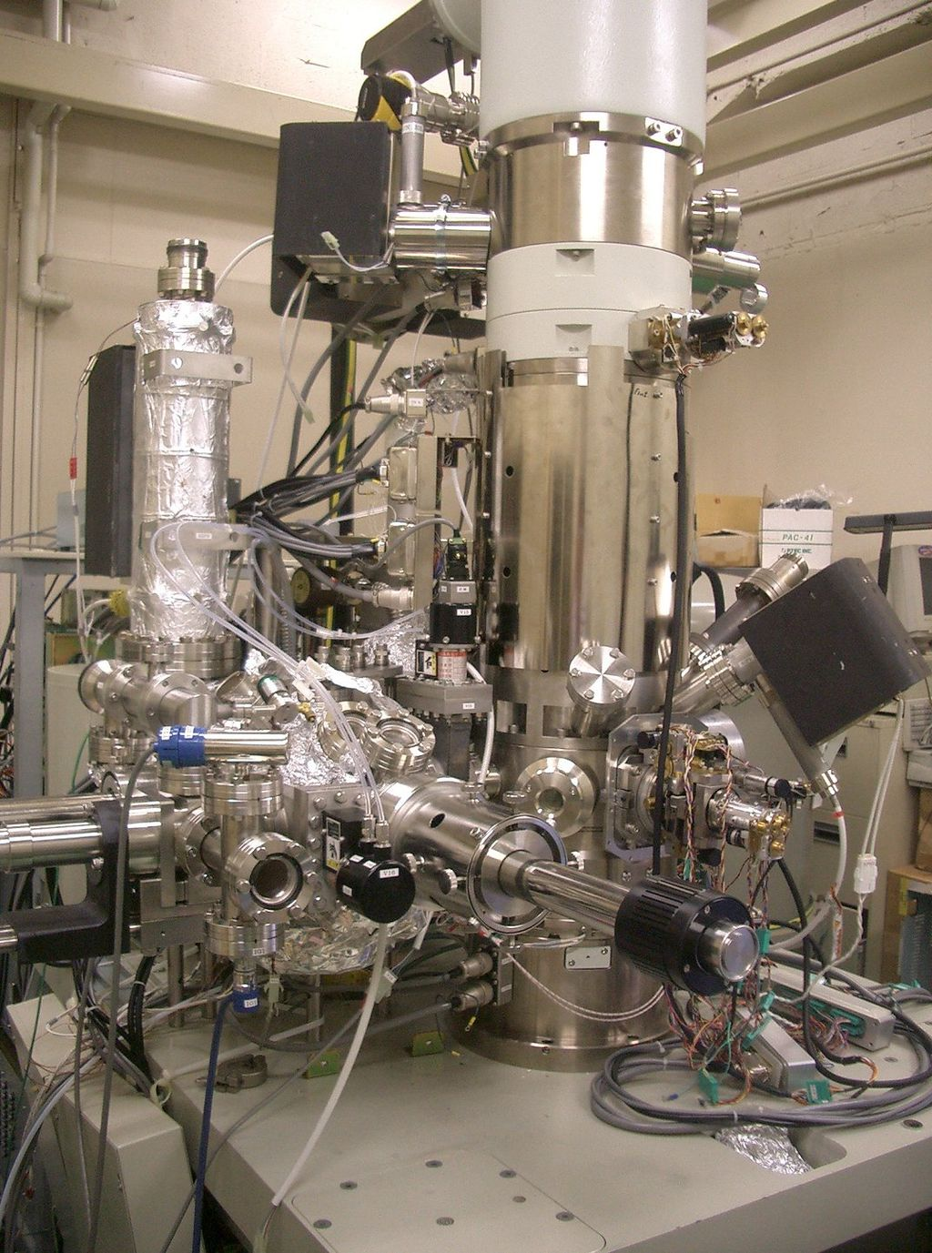
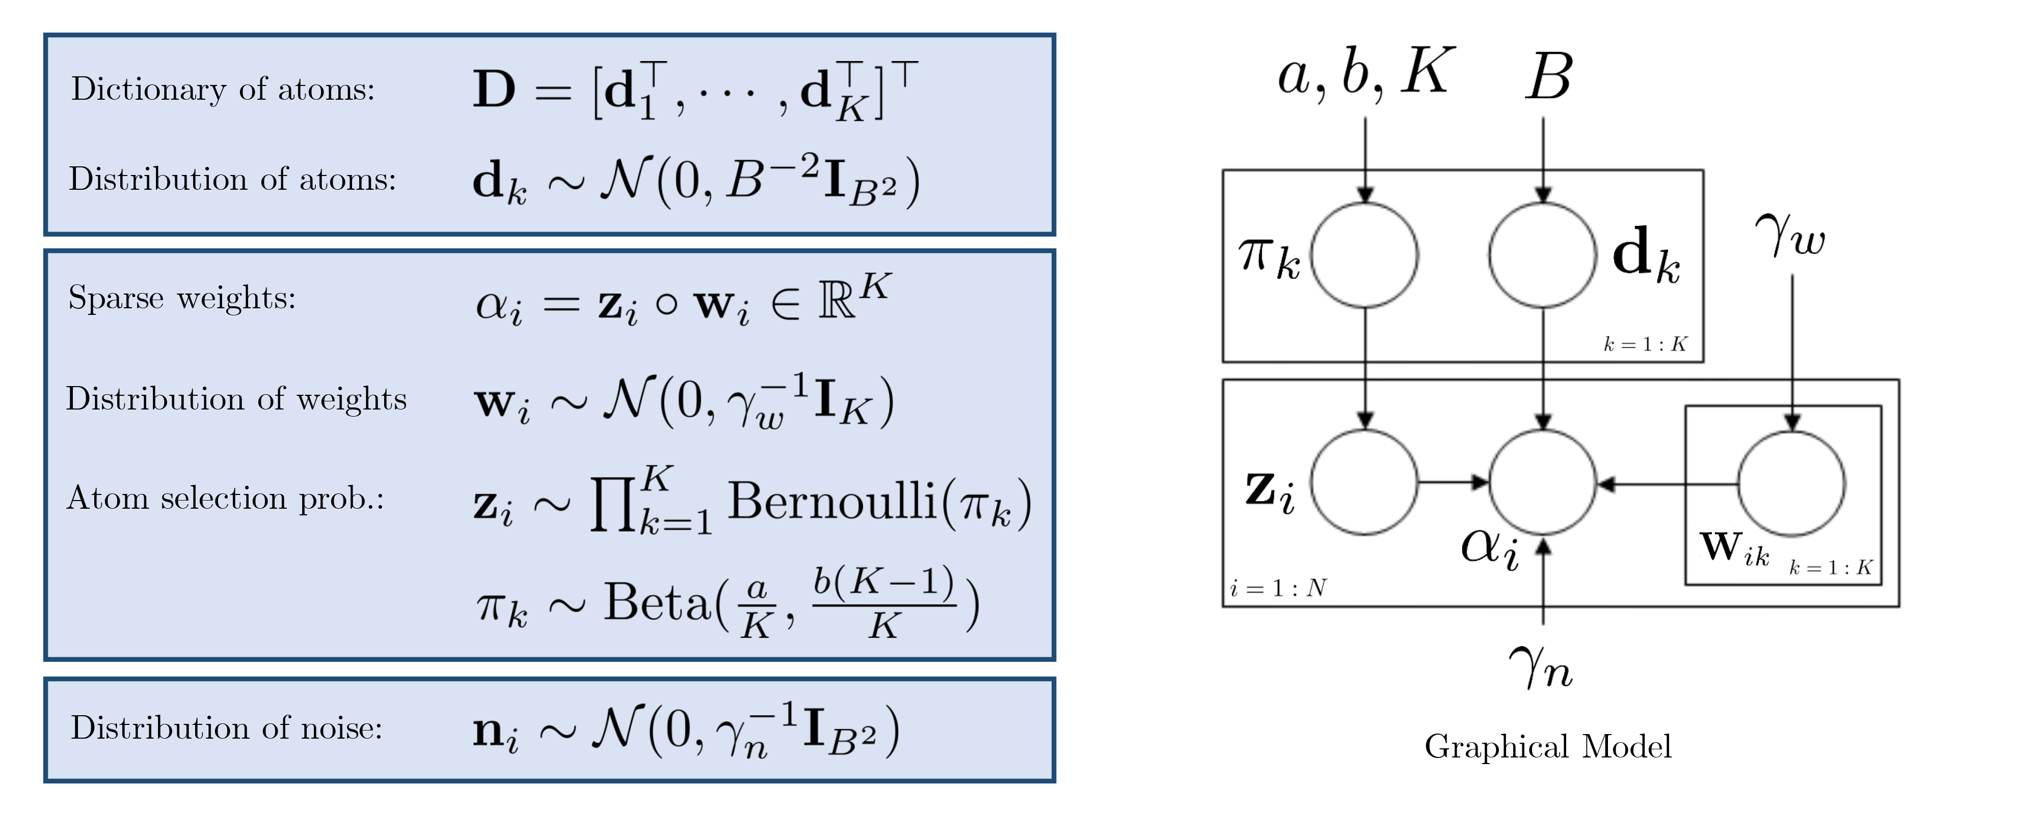


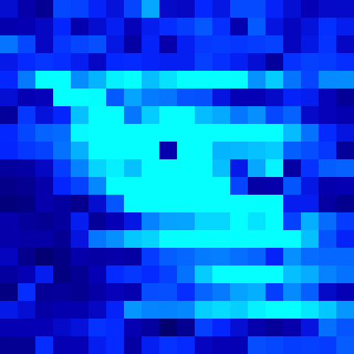
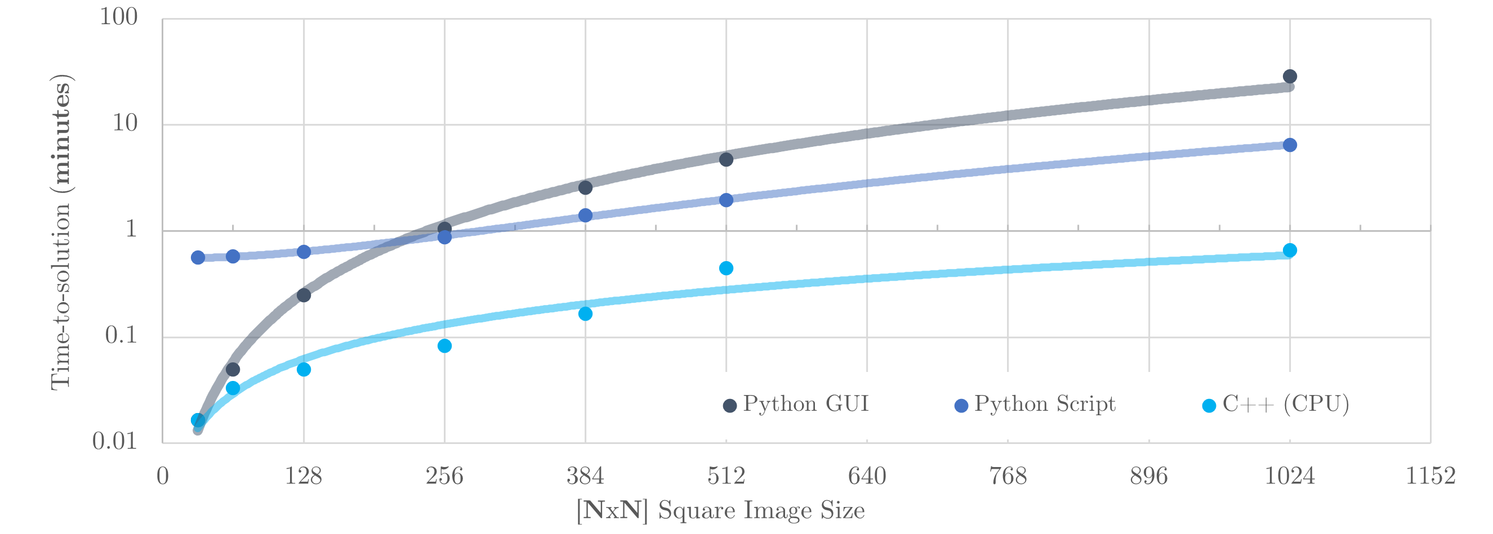

Computational Methods for Compressive Sensing driven Scanning Transmission Electron Microscopy (CS-STEM)
Context
Goal
Model
Perform a sub-sampled Scan
Faster Acquisition
Reduced Beam-Damage
Reduced Drift (3D STEM)
25%
Time-To-Solution
Reconstruct
100%
Image: A Typical Scanning Transmission Electron Microscope (source: Wikipedia)
Recover fully-sampled Image
Jack Wells

Slide 21
Dynamics

Slide 22
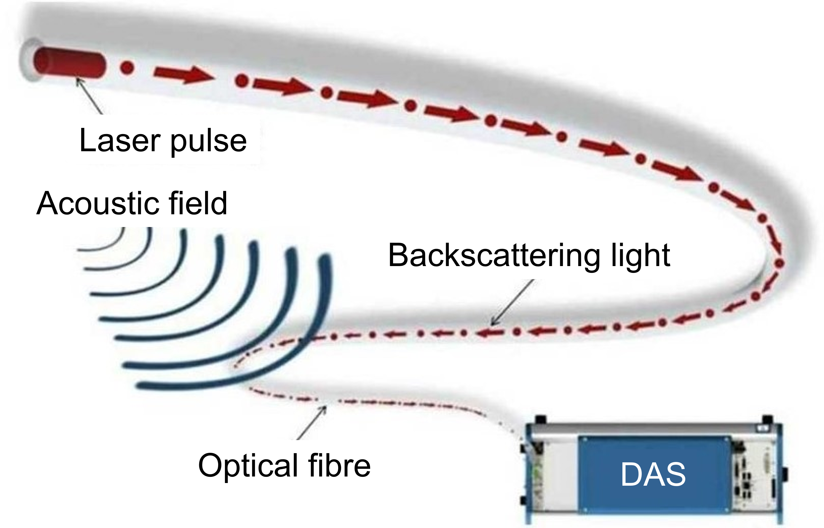
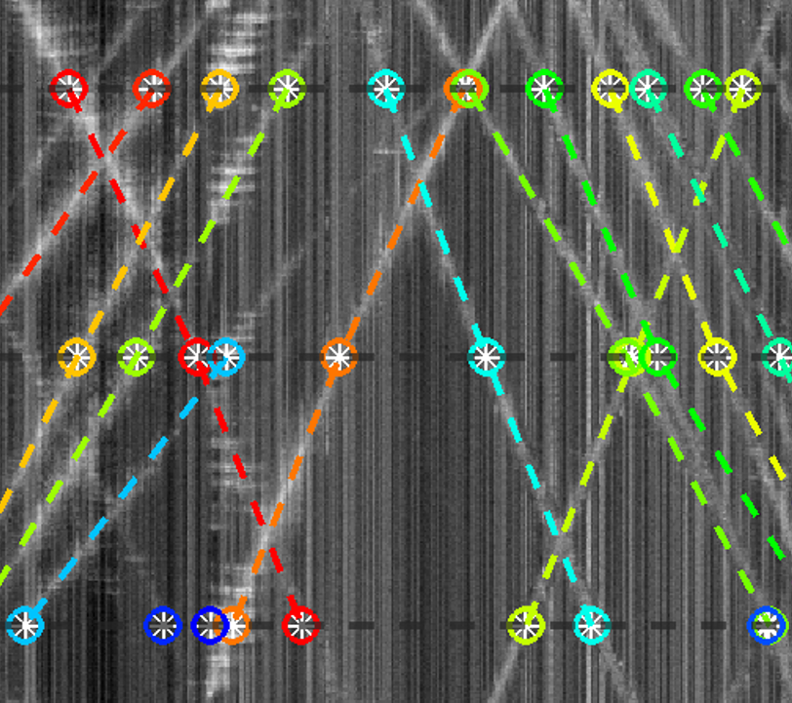
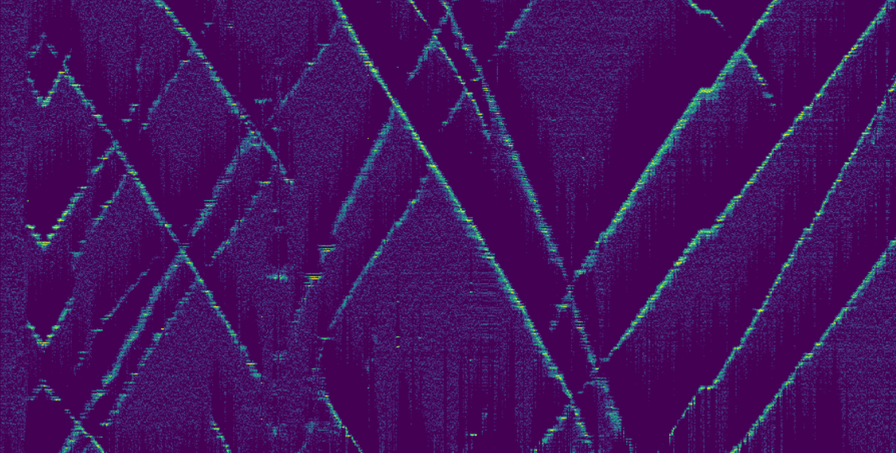
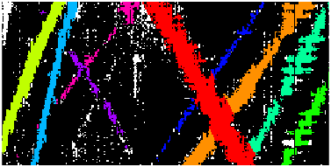


Traffic monitoring with Distributed Acoustic Sensing (DAS)
Detector
Tracker
Sensor
Data
Measurements
+ noise
+ false targets
- misdetections
Time
Distance
Modelled as an array of microphones
Time-varying and location- dependent noise
Tracklet measurements
Target state
estimation
Estimated
partial
trajectories
Marco Fontana
Time

Slide 23




A MULTI-BERNOULLI GAUSSIAN FILTER FOR TRACK-BEFORE-DETECT
Why use Track-Before-Detect?
What is novel about my work?
What do the results show?
$$p\left(z_{k}\right)≈N\left(z_{k};h\left(x^{u}\right)+{\tilde{z}}_{corr}^{u},R+S_{corr}^{u}\right)$$
ELINOR DAVIES

Slide 24


Passive Localisation with Geometric Objectives
Igor Potapov Gareth Rees Jason F. Ralph
Our objective: localise the position of $k$ static emitters in an area with $m$ mobile sensors
Passive sensors do not scan only listen (receive an angle of possible direction)
New geometric approach to obtain reliable polygonal bounds on the emitters’ positions with no initial assumptions
The approach can complement more sophisticated methods based on Bayesian inference and can be used as a framework for designing other high-level strategies
Theofilos Triommatis

Slide 25






Scalable Track Analytics: Ship Type Classification Manolis Pitsikalis, supervised by Alexei Lisitsa, Patrick Totzke and Simon Lee e.pitsikalis@liverpool.ac.uk
Identify the ship type of vessels using vessel imagery and AIS data with a neuro fuzzy model that combines logic rules with deep learning.

Slide 26




Scalable Track Analytics: Stream Processing Manolis Pitsikalis, supervised by Alexei Lisitsa, Patrick Totzke and Simon Lee e.pitsikalis@liverpool.ac.uk
Development of the Phenesthe Complex Event Processing System
Logic based language, formally presented with semantics and execution semantics.
Allows the definition and the detection of instantaneous and durative temporal phenomena.
Documented and available in manospits.github.io/Phenesthe
Maritime surveillance in a near port environment
Evaluation of Phenesthe on real maritime data streams provided by Denbridge Marine Ltd.
Real-time performance even on a standard office computer.

Slide 27
Scalable Track Analytics: Outro Manolis Pitsikalis, supervised by Alexei Lisitsa, Patrick Totzke and Simon Lee e.pitsikalis@liverpool.ac.uk
Current & Future work:
Temporal phenomena definition learning using historical logs.
Assessment of the expressiveness of the language of Phenesthe.
Evaluation of the phenomena learning algorithm on the maritime and other use cases.
Selected publications during the PhD period:
Pitsikalis, M., Do, TT., Lisitsa, A., Luo, S. (2021). “Logic Rules Meet Deep Learning: A Novel Approach for Ship Type Classification”. In: RuleML+RR 2021. (Harold Boley award for most promising paper)
Pitsikalis, M., Lisitsa, A., Luo, S. (2022). “Representation and Processing of Instantaneous and Durative Temporal Phenomena”. In: LOPSTR 2021.
Pitsikalis, M., Lisitsa, A., Totzke, P., Lee, S., “Making Sense of Heterogeneous Maritime Data”. In: MDM 2022.
Pitsikalis, M., Do, TT., Lisitsa, A., Luo, S. (2022). “Logic Rules Meet Deep Learning: A Novel Approach for Ship Type Classification (Extended Abstract)”. In: IJCAI 2022.
Mantenoglou, P., Pitsikalis, M., Artikis, A. (2022). “Stream Reasoning With Cycles”. In: KR 2022.
Fikioris, G., Patroumpas, K., Artikis, A., Pitsikalis, M. and Paliouras, G., 2022. “Optimizing vessel trajectory compression for maritime situational awareness”. In: GeoInformatica 2022.

Slide 28
Control

Slide 29



Distributed Hypothesis Generation & Evaluation
Fig. 1: An argumentation mining pipeline for an example text corpus (from [1]).
Fig. 2: U.S. Marines and British Army collaborating on military intelligence (from [2])
Jordan Robinson
[1] Lippi, M. and Torroni, P., 2016. Argumentation Mining. ACM Transactions on Internet Technology, 16(2), pp.1-25. [2] https://www.dvidshub.net/image/2261562/us-marines-british-army-collaborating-military-intelligence

Slide 30





Scheduling of Distributed information processing
Scheduling
Sensor Management
Network Emulation
Statistical Emulation
Reinforcement Learning
Alex Bird
Notes:
Add completed location graph. Include model picture. Include paper figure after my work. Make it clear that its from a paper. General image for sensor network

Slide 31


Cooperative and Coordinated Guidance For Adversarial Engagements
Problem definition:
Modern warfare deals with a array of intelligent threats. How to optimise the effectives of resources by the use of cooperation and coordination?
Proposed Solution:
To create network of parallel TEWAs (Threat Evaluation and Weapon Assignments) that can deal with an overwhelming number of threats using coordinated and cooperative responses in a decentralised architecture.
Current Work:
Current work focuses of implementation a Weapon Assignment Algorithm which is robust and reliable under high volume of data with incomplete entries.
Fig 1. Tracking of 100 targets
Fig 2. Simultaneous interception of multiple threats
Julia Kolaszynska

Slide 32




Scheduling Surveillance of Space Objects
Problem: There are too many satellites and not enough telescopes
Solution: Using reinforcement learning to use limited sensor resources better
Focused on non-myopic (long term) solutions
Benedict Oakes

Slide 33

Non-myopic Approaches to Sensing and Surveying
George Jones

Slide 34
Non-myopic Approaches to Sensing and Surveying
Myopia – short sightedness
George Jones

Slide 35
Non-myopic Approaches to Sensing and Surveying
Sensor Management – making decisions for an agile sensor platform
George Jones

